Slide 1

The value and importance of physical activity (not just PE) to whole school life.
Adam Baker
Strategic Lead for Physical Activity
Public Health
Suffolk County Council

Slide 2

Schools are uniquely placed to help children become more healthy and active
Take Home Message – Physical activity is a win/win for both child and school.

Slide 3
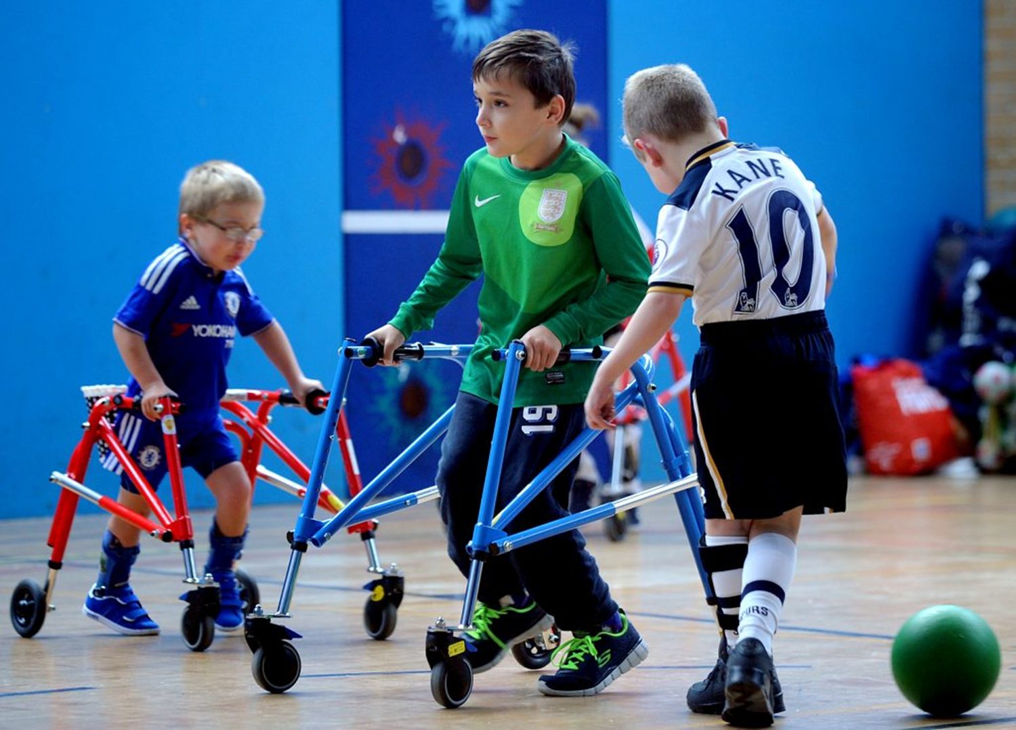
Presentation Format:
How active our children should be;
How active our children currently are;
The benefits that children derive from being active;
The benefits that schools gain from having active pupils;
The importance of a whole school approach.

Slide 4
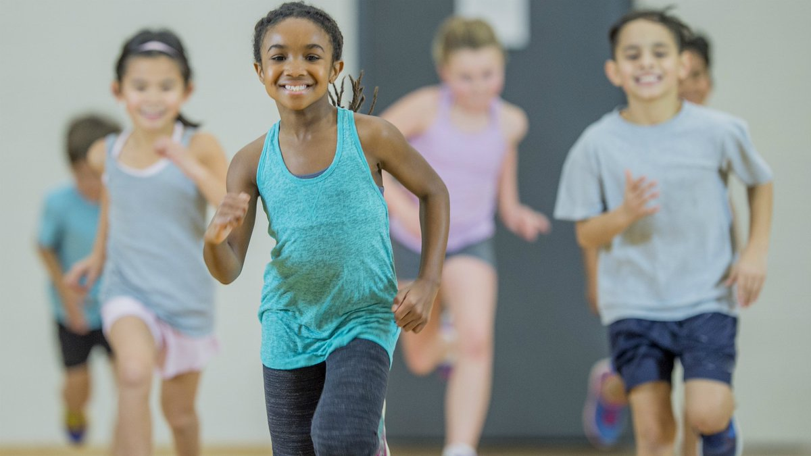
Question?
How active should children aged 5-18 years be?

Slide 6

Question:
What proportion of children achieve recommended physical activity levels?

Slide 7

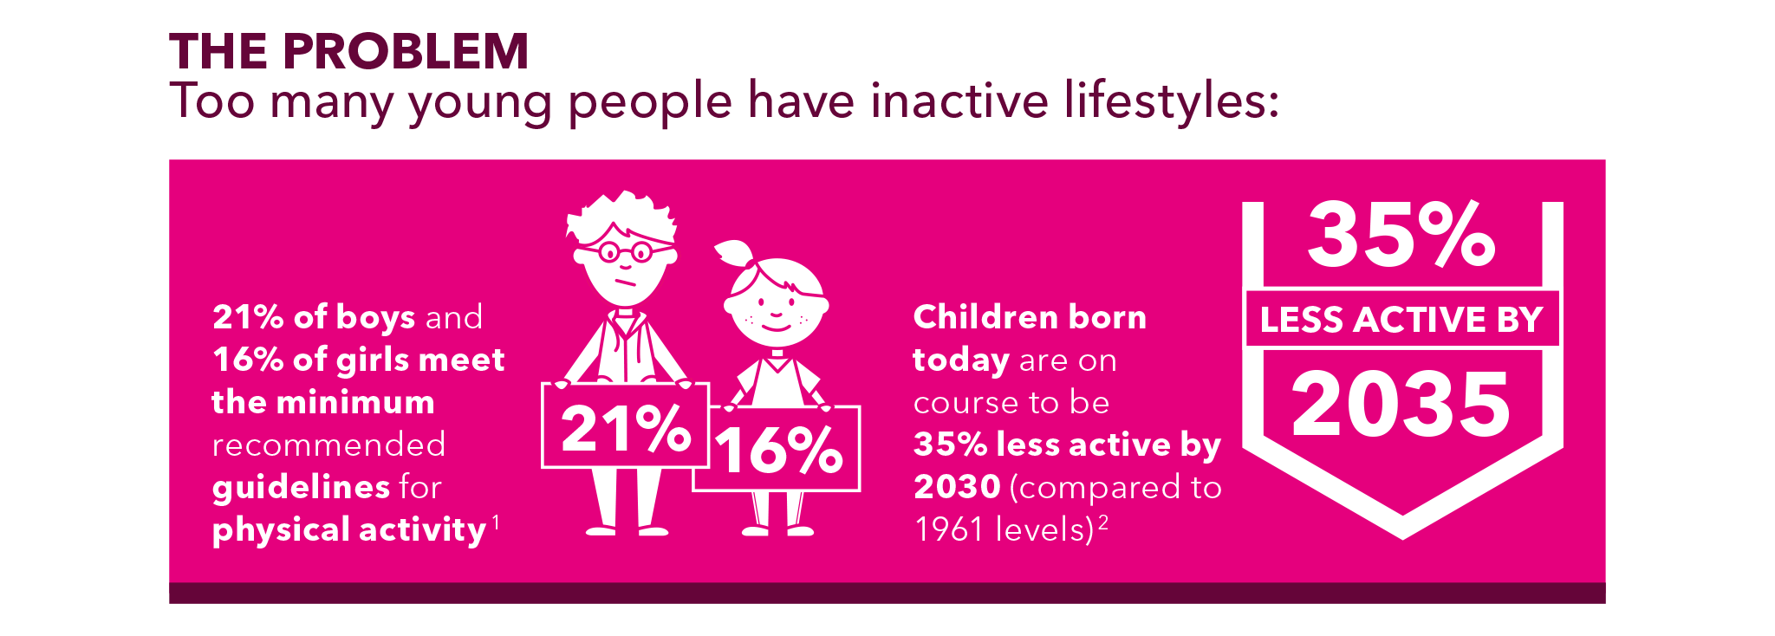

Slide 8
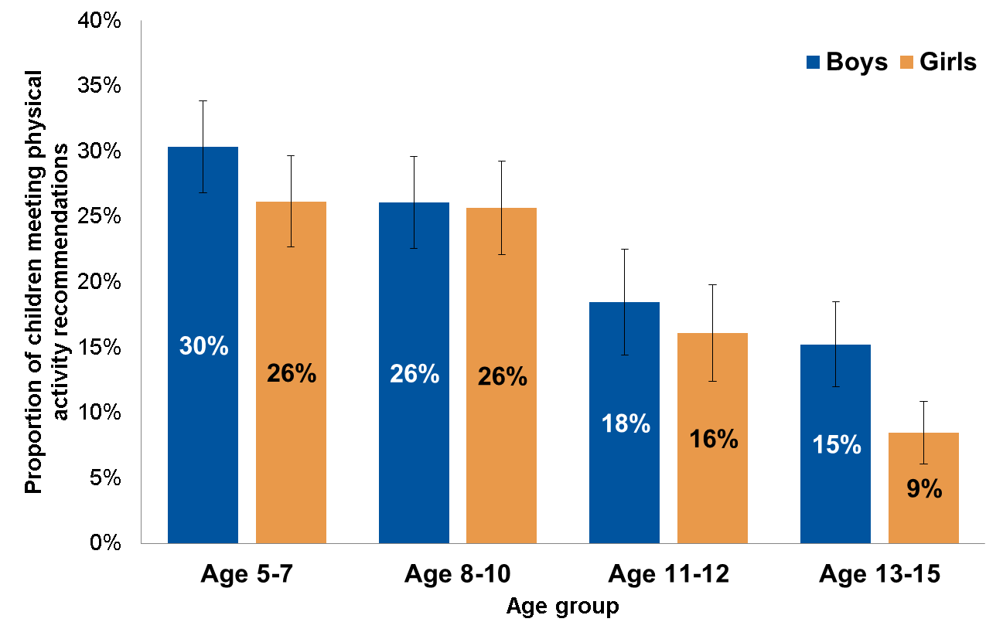
Physical activity in children by age
Proportion of children aged 5 to 15 meeting physical activity recommendations (excluding activities in school lessons), by age and sex, 2015
Source: Health Survey for England 2015, NHS Digital http://www.content.digital.nhs.uk/catalogue/PUB22610
Meets recommendations | At least 60 minutes (1 hour) of moderate to vigorous physical activity (MVPA) on all 7 days in the last week.

Slide 9
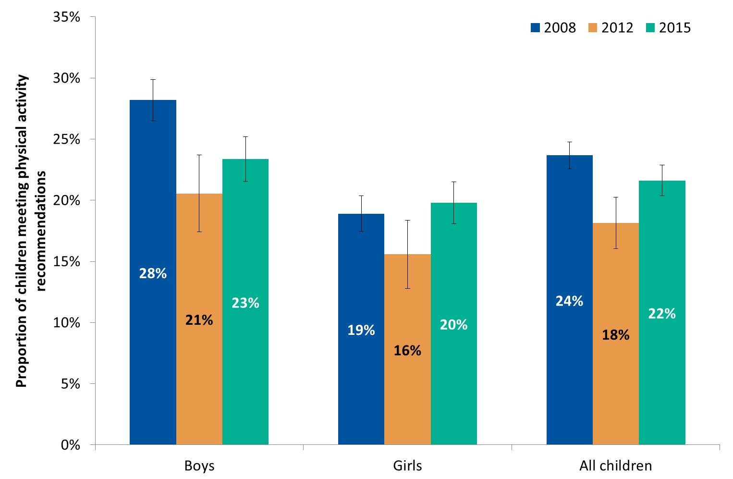
Trends in physical activity
Proportion of children aged 5 to 15 meeting physical activity recommendations (excluding activities in school lessons) in 2008, 2012 and 2015
Source: Health Survey for England 2015, NHS Digital http://www.content.digital.nhs.uk/catalogue/PUB22610
Meets recommendations | At least 60 minutes (1 hour) of moderate to vigorous physical activity (MVPA) on all 7 days in the last week.

Slide 10
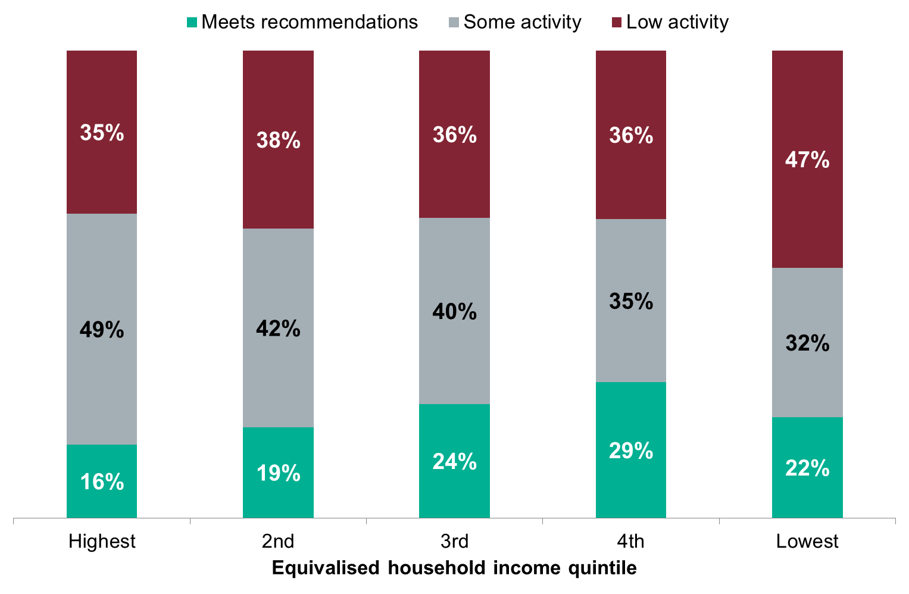
Physical activity levels by income
Proportion of children aged 5 to 15 meeting physical activity recommendations (excluding activities in school lessons), by incomeª, 2015
95% CI: 39%-48%
95% CI: 26%-37%
Source: Health Survey for England 2015, NHS Digital http://www.content.digital.nhs.uk/catalogue/PUB22610
ª Equivalised household income is a measure that takes account of the number of people in the household. For this analysis, households were split into 5 equal-sized groups banded by income level (income quintiles). Physical activity levels were compared between these groups.
Low activity | Low activity refers to lower levels of physical activity (less than 30 minutes of MVPA on all 7 days in the last week, or less than 60 minutes of MVPA on 3 to 6 days in the last week).

Slide 11
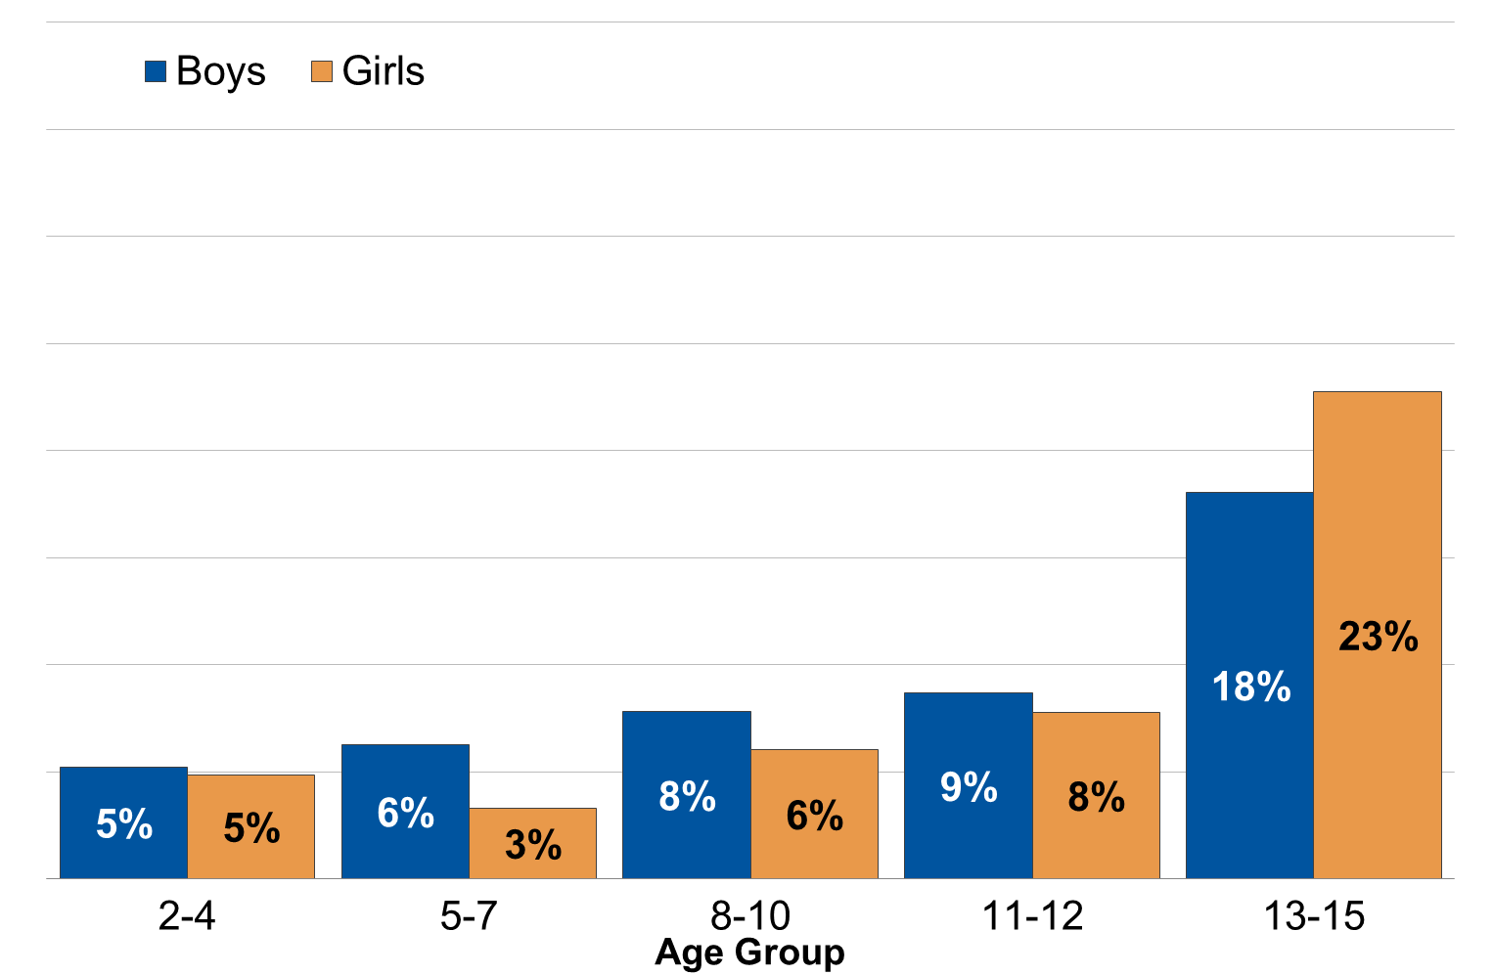
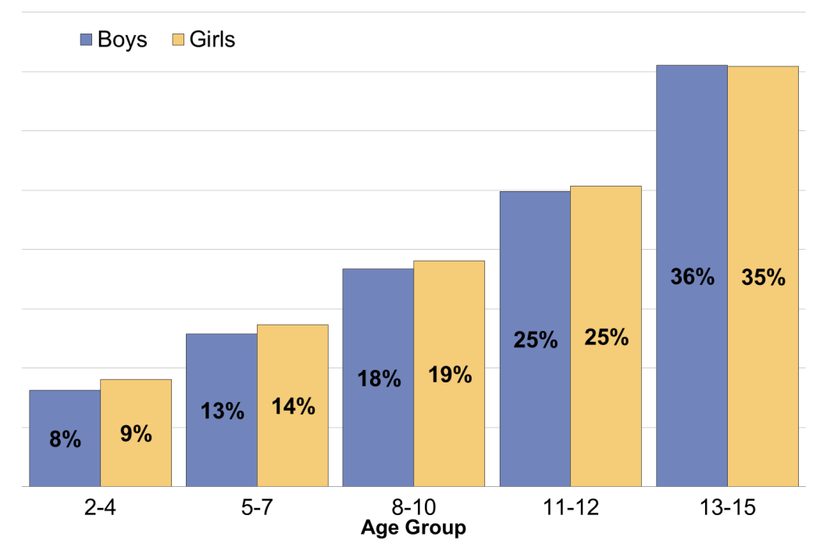
Time spent sedentary in leisure time
Proportion of children aged 2 to 15 who were sedentary for 6 or more hours per day on weekdays and weekend days, by age and sex, 2015
Weekdays
Weekends
Source: Health Survey for England 2015, NHS Digital http://www.content.digital.nhs.uk/catalogue/PUB22610
Sedentary time | Average time children spend watching TV or sitting down doing any other activity. For example, reading, doing homework, using a computer, or playing video games. Sedentary time excludes time at school.

Slide 12
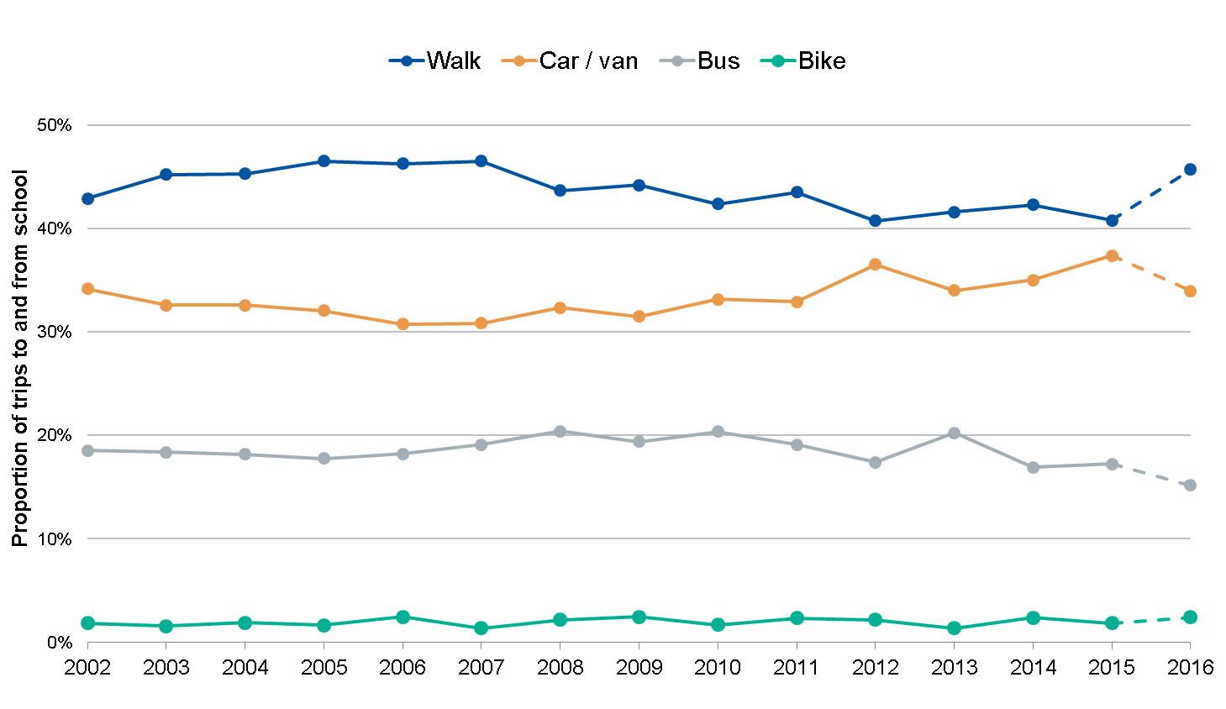
Trends in travel to school
Proportion of trips to and from school for children (aged 5–16 years) by main mode of transport, 2002 to 2016ª
Source: National Travel Survey 2016, Department for Transport https://www.gov.uk/government/statistics/national-travel-survey-2016
ª In 2016 short walks (of less than a mile in length or less than 20 minutes duration) were recorded on day one for half the sample, and day 7 for the other half of the sample. In previous years, short walks have only been recorded on day 7 of the travel diary. Collecting data on short walks on day one of the travel week has increased the number of short walks reported, which means a break in the time series between 2016 and earlier years.

Slide 13
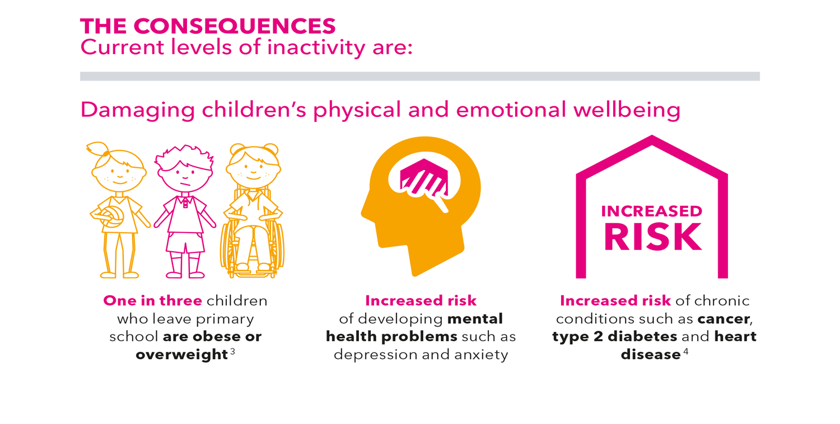

Slide 14
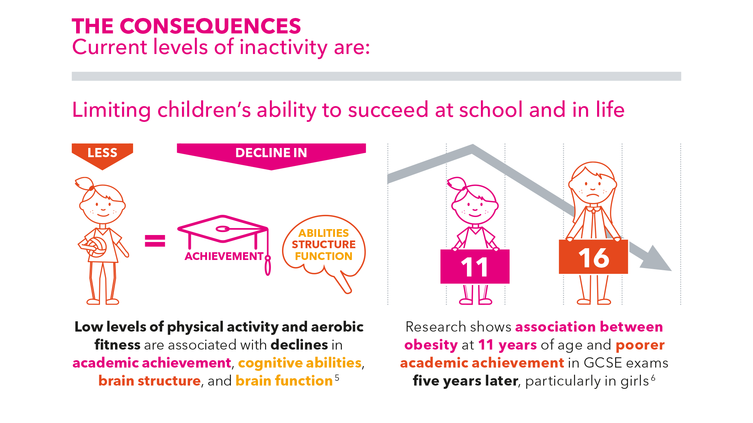

Slide 15
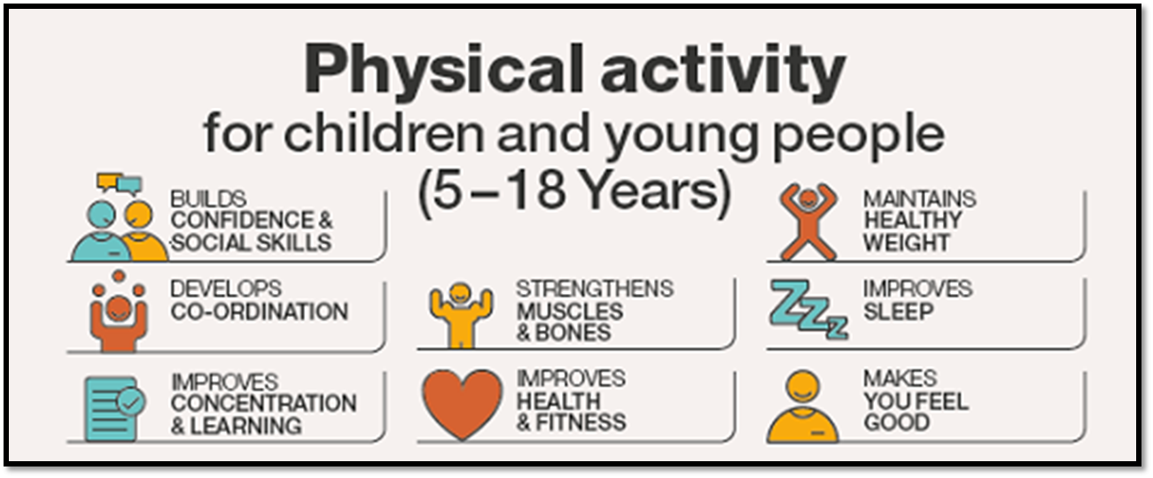
What benefits do children derive from being active?
‘Being physically active is one of the key building blocks for a healthy life’

Slide 16
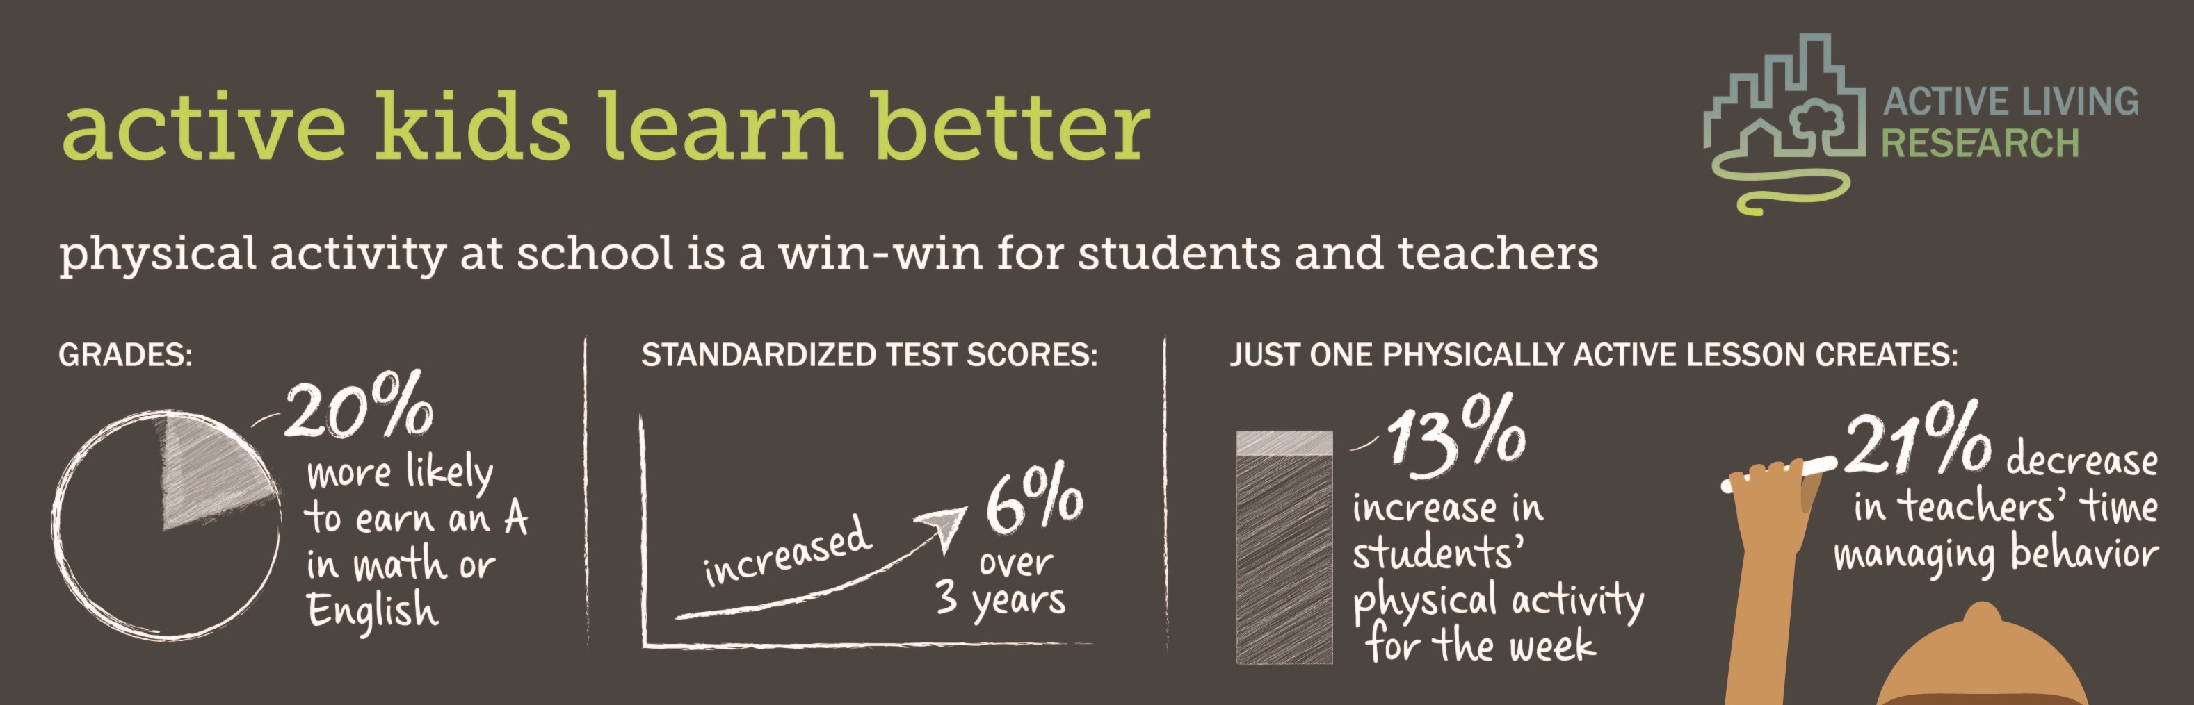
What are the benefits in terms of learning?

Slide 17
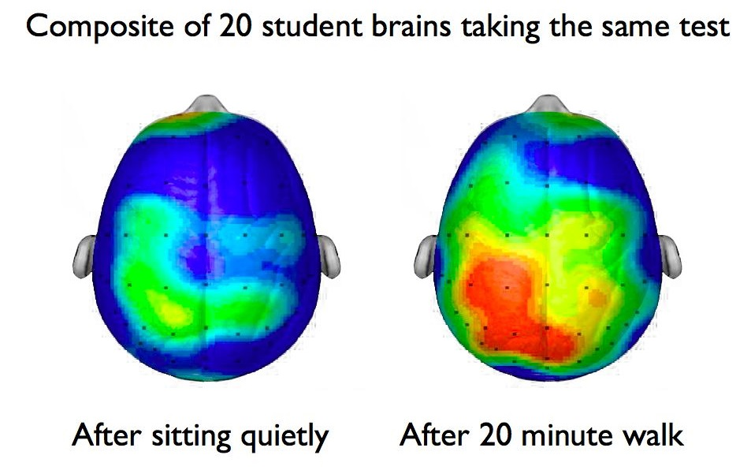
The colour blue represents lower neural activity, while the colour red denotes higher brain activity in a given region.

Slide 18
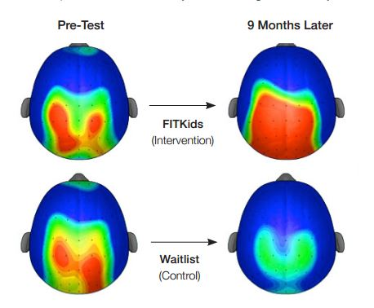
Physical Activity Before and After School
Red = high brain activity, blue = low neural activity

Slide 19
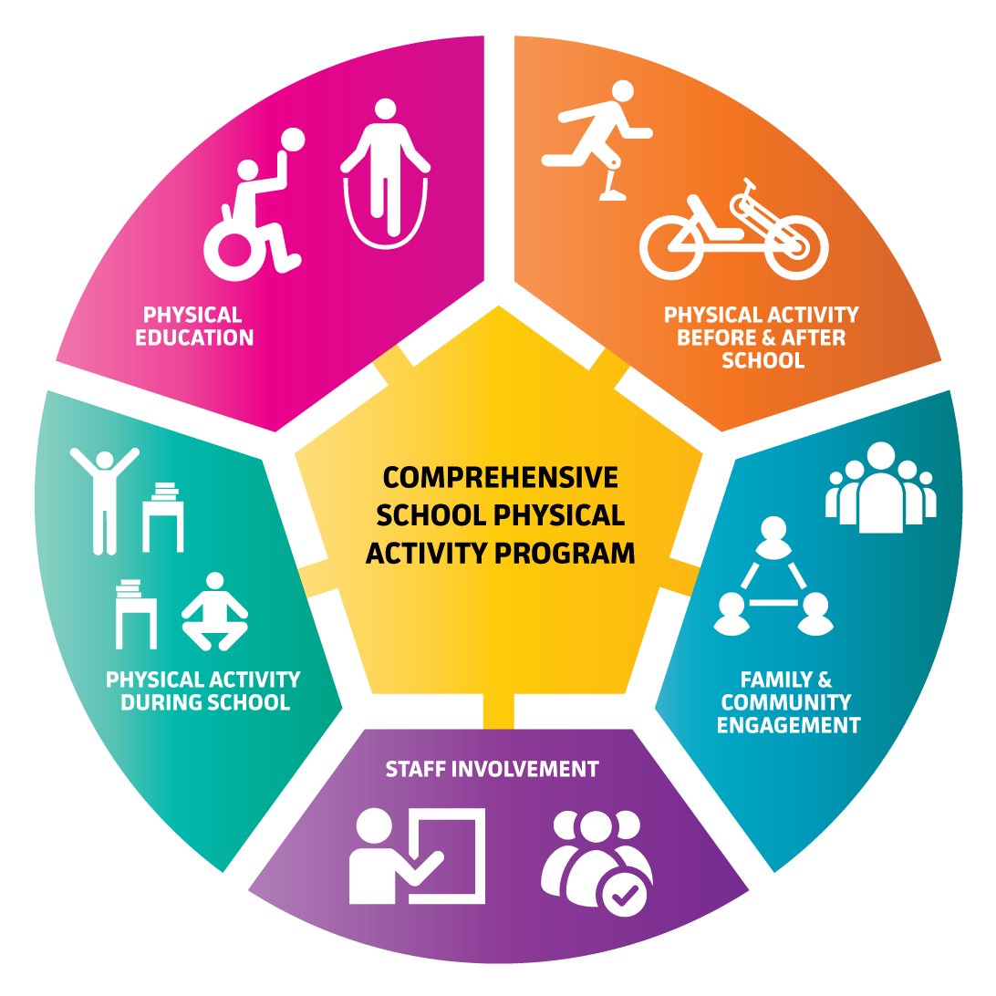
Whole School Approach is Essential
CSPAP is an evidence-based, data driven, physical activity improvement model developed by the Society of Health and Physical Educators in America and recommended by the Centres for Disease Control and Prevention.

Slide 20

Physical Education
One study has suggested that the greatest cognitive benefits from physical education resulted when physical education classes are scheduled during the early or middle part of the day.

Slide 21
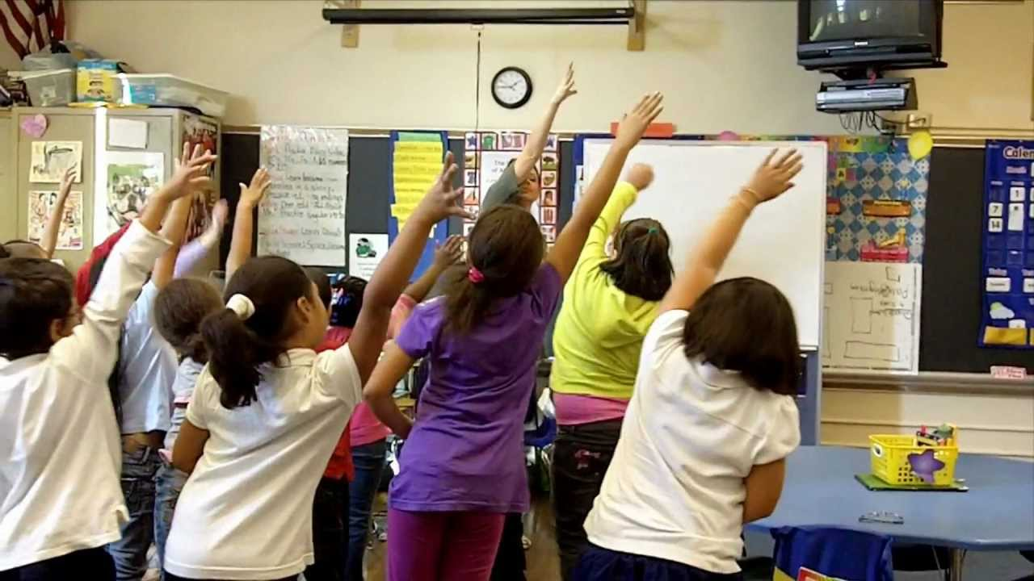
Physical Activity During School
Integrating physical activity into academic classroom teaching as well as providing breaks from teaching specifically for physical activity.

Slide 22
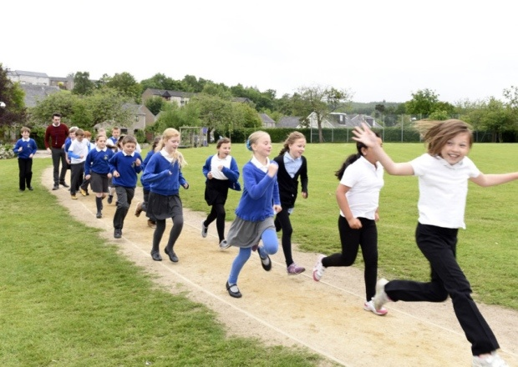

The Daily Mile
(www.dailymile.co.uk)
A popular, simple and free initiative that sees children run/walk/jog for 15 minutes every day in their primary and nursery schools.

Slide 23
Research from the Universities of Edinburgh and Stirling
Purpose – To explore the impact of taking a short break from the classroom to complete a physical activity on children’s mood, attention and memory.
Conclusions:
Children felt more awake after exercise and happier after self-paced activity;
Exercise helped children to respond quicker but less impulsively;
The run/walk helped to improve children’s verbal memory
“15 minutes of self-paced exercise can significantly improve a child’s mood, attention and memory – enhancing their ability to learn”
Dr Naomi Brooks, University of Stirling’s Faculty of Health Sciences and Sport

Slide 24

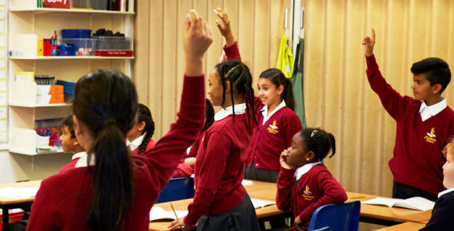

Active Movement empowers teachers to integrate non-sedentary behaviour and add low-level activity into the classroom, around the school and even at home without class disruption or compromising teaching time.

Slide 25


Slide 26
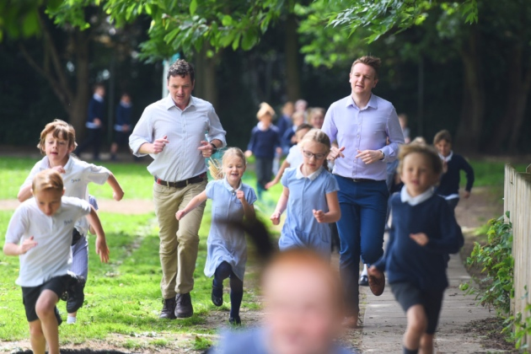
Staff Involvement
‘Behaviour change needs role models if it is to be effective and long-lasting’
‘The physical and emotional benefits of exercise are just as relevant to adults as they are to children.’

Slide 27
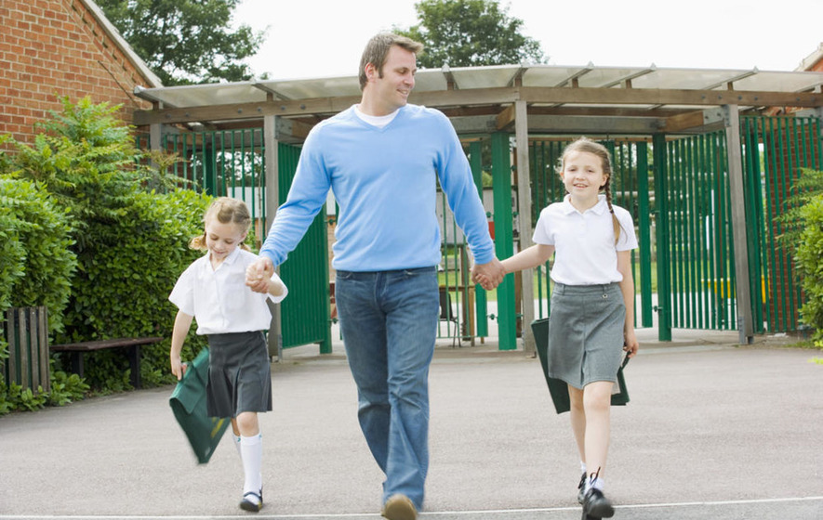
Family and Community Engagement
‘When parents are engaged in their children’s school activities, their children get better grades, choose healthier behaviours, and have better social skills’

Slide 29
Key Messages
There are strong links between fitness/physical activity and cognition and academic achievement in children;
Other benefits include improved emotional wellbeing, confidence, behaviour and social skills;
A whole school approach, including family and community engagement, should be taken when it comes to physical activity;
The Daily Mile is a good example of engaging primary school aged children in physical activity during the school day.

Slide 30
Thank you

