Slide 1
Developing your Curriculum PE Offer
Reviewing and reflecting upon practice
- a one-day course

Slide 2
Welcome
Introductions and outline for the day
Activities covered today are also well linked to our National Level 4 Qualification in Leadership & Management in Primary PE
Non-QTS staff cannot undertake afPE’s Level 6 Subject Leadership but may have done Level 5 award. This has been mapped to our qualification so accreditation of prior learning (apl) can be given.

Slide 3
Quick Discussion
Look at the slip provided
What are your initial thoughts?
This is a real plan from a school – Medium-term plan from which teachers must plan
1 lesson per week, Year 3, 6 lessons - Gymnastics

Slide 4
Learning Objectives
To reflect upon current practice, share ideas and practice, challenge practice
To review your curriculum offer and its alignment with your wider school vision and values, aims and ethos to place PE at the heart.
To consider what it means to ‘Get Better in PE’ in your school
How will ALL pupils be inspired to succeed and excel?
Reflect upon your provision – is it ambitious enough?
How are motor competencies developed along with knowledge of rules, strategies and tactics?
How is confidence and competence developed to ensure the NC aims as well as helping to ensure pupils are informed performers who make healthy participation and active life choices

Slide 5
Additional Outcomes
We’ll work to help ensure that you have everything you need to answer the following five Ofsted Deep Dive type questions:
How well does the KS1 curriculum introduce pupils to your subject and build upon learning from EYFS?
Why were the units of work on your curriculum map chosen?
What rationale do you have for the order in which content is taught over time?
How are you approaching the teaching of specific subject vocabulary in your subject?
How are you planning for progression in PE?

Slide 6
Let’s celebrate to start
We don’t do this enough!
Consider everything that you do and that your school does in terms of PE (curriculum that ALL pupils receive and engage in)
List these down on a post-it note / piece of paper so that they can be referred to later
These are your strengths and maintenance priorities

Slide 8
Ofsted new video
https://youtu.be/jMdKdlK4AGA

Slide 10
Defining PE – for clarity
What is Physical Education (PE)?
Task – write a brief definition of PE with a colleague(s)
This is not a test, or assessed but rather a chance to reflect and discuss what Physical Education is and discuss some key terms, vocabulary that is banded about at present by Ofsted, HMCI, afPE and others for clarity and your consideration

Slide 12
Terminology
‘efficient and effective movement’
‘competence and confidence’ – what does it mean to be competent? Competent in what?
How will pupils be facilitated to ‘know more’ and to ‘do more?’
‘developing purposeful understanding’
procedural knowledge – ‘know how’ (how well do pupils demonstrate a movement)
declarative knowledge – ‘know what’ (how well do pupils recall teaching points, rules, tactics etc)

Slide 13
TOP TIP!
Have you ever considered using an approach which allows pupils to:
“Show me what you know…..or can do!”
This approach can serve as a simple but highly effective dynamic diagnostic assessment.
Give it a go when introducing a new concept / area of activity / skill even. You might be very pleasantly surprised
Works brilliantly as a ‘Whole – Part – Whole’ approach.

Slide 14
To consider….
It is possible that for some pupils in your school, the planned PE lessons may be the only physical activity that they get a week
W.H.O. recommends an hour a day
UK C.M.O. recommends same and that 30mins should be in school time
TASK:
How much time a week?
How often – frequency?
To what intensity?
Sometimes referred to as the F.I.T. Principle
Frequency, Intensity, Time
Sometimes F.I.T.T. where the second ‘T’ refers to Type of activity

Slide 16
What does Outstanding look like?
Important to have a reference point
The exemplar we are using is based on the Ofsted Education Inspection Handbook (2019)

Slide 17
What is the ‘Big Picture?’
In order to create a Vision for PE at your school you need to know the end picture
Like a jigsaw puzzle – start with the picture and assemble the bits to produce it
This is also like ‘Teaching Backwards’ – starting with the end point and working backwards
What will they look like at Year 6?
What will they have experienced?
What will they be able to do, know etc.?
Can it be articulated?
Where are you on building the framework? Corners in? Sky done?

Slide 18
Non-negotiables
Have you any non-negotiables?
These are pieces of the puzzle which you feel are essential
Could be –
Value of a residential experience
Learn to swim over 25m (location/finance)
Competition – for all (intra / inter)
Leadership - pupil
Fitness and Health (making a difference)
Think of these a little like the corner pieces of your puzzle
Sometimes these are forced upon you e.g. wider whole school non-negotiables or curriculum design principles

Slide 19
Alignment
How does PE align with whole school vision and values, ethos, aims etc?
Have you ever really looked?
Can be easier to gain buy-in to PE when others can see ‘hooks’ or when they feel supported through PE
Find your schools website and look at the
vision and Values / Aims or ethos and highlight
where PE can/ should make an impact.

Slide 20
Your School
Jot down your school’s facilities (on-site)
Jot down a few words which reflect your parents / community in terms of socio-economics, engagement, jobs, support, education
In a separate column jot down access you have to other facilities in your community
What ‘clubs’ / wider opportunities do pupils have locally?
Now rationalise and consider and reflect upon who gets the best deal in PE at your school based on your knowledge of pupils, parents, community etc. – who the least. Consider Equality and Equity

Slide 21
TIB’s
Everything so far is about getting you to consider the framework of what you need
What is your context
What your pupils need to be competent
This will allow you to have a strong rationale for the choice of content
What sports and physical activities do you choose to help ensure all pupils are developing competence - so that they know more and do more

Slide 24
Ofsted
‘Schools have the flexibility to choose their curriculum approaches as long as there has been sufficient time in considering
Content
Structure
Sequence
Implementation’
You need to be able to rationalise why your curriculum offer looks the way it does – why did you choose the content, why is it structured the way it is, why is it sequenced like this and how will you implement it
Is it ‘ambitious enough?’ – let’s start here. Have you heard this?

Slide 25
Healthy Participation
Have a conversation with colleagues on your table
What knowledge do pupils need to make informed purposeful decisions about their own involvement in healthy and active participation throughout their lives?
Planning & sequencing the knowledge of Healthy Participation
Allowing for a ‘richer understanding of issues and participation around sport and physical activity’ - Ofsted

Slide 26
TOP TIP!
By considering content for what you might introduce to pupils in terms of vocabulary, science, PE you might look at:
Muscles or skeletal system
Let’s just have a quick aside and play the ‘Sticker Game’
This is not a separate curriculum but rather discrete embedded learning which supports wider learning.

Slide 27
Section 2 National Curriculum PE
Using your reference sheet
Physical Education programmes of study: key stages 1 and 2 National Curriculum in England
Purpose of study: A high-quality physical education curriculum inspires all pupils to succeed and excel in competitive sport and other physically-demanding activities. It should provide opportunities for pupils to become physically confident in a way which supports their health and fitness. Opportunities to compete in sport and other activities build character and help to embed values such as fairness and respect.

Slide 28
Section 2 National Curriculum PE
Using your reference sheet
Physical Education programmes of study: key stages 1 and 2 National Curriculum in England
Purpose of study: A high-quality physical education curriculum inspires all pupils to succeed and excel in competitive sport and other physically-demanding activities. It should provide opportunities for pupils to become physically confident in a way which supports their health and fitness. Opportunities to compete in sport and other activities build character and help to embed values such as fairness and respect.

Slide 29
The Aim of NCPE (2014)
The national curriculum for physical education aims to ensure that all pupils:
develop competence to excel in a broad range of physical activities
are physically active for sustained periods of time
engage in competitive sports and activities
lead healthy, active lives.
Illustrate how competence (and confidence) link across all four of the NC aims

Slide 30
Reflection
Consider your own school setting initially.
Who do you feel get the ‘best deal’ in terms of PE at your school and why? What group?
Who do you feel get the ‘worst deal’ in terms of PE at your school and why? What group?
Talk to others for their own opinions on their context

Slide 31
Ofsted’s Research
Throughout their research ‘we have seen and shown the importance of three things in terms of implementing the national curriculum aims:
1) High-quality Instruction
2) Practice
3) Feedback
What are the ramifications for us as PE leads?
Consider these in terms of our curricular offer, our curriculum, and how it is implemented

Slide 32
Monitoring & Evaluating
Some thoughts
Teachers CPD – their knowledge, skills & understanding in the subject
[Staff PE Skills Audit – confidence & competence] *Free template
Consistency of approach
Practice – do staff understand this and provide sufficient time?
Feedback – how, when, who, what, where? [Performance Pairs etc.]
KLOE: - What do YOU know? How do you know it and what evidence do you have?

Slide 33
Teacher’s Subject knowledge
Pupils should be taught to: master basic movements including running, jumping, throwing and catching, as well as developing balance, agility and co-ordination, and begin to apply these in a range of activities; participate in team games, developing simple tactics for attacking and defending; perform dances using simple movement patterns.
Pupils should be taught to: use running, jumping, throwing and catching in isolation and in combination; play competitive games, modified where appropriate [for example, badminton, basketball, cricket, football, hockey, netball, rounders and tennis], and apply basic principles suitable for attacking and defending; develop flexibility, strength, technique, control and balance [for example, through athletics and gymnastics]; perform dances using a range of movement patterns; take part in outdoor and adventurous activity challenges both individually and within a team; compare their performances with previous ones and demonstrate improvement to achieve their personal best.
What are the common principles of Attack and Defence in terms of Games?

Slide 34
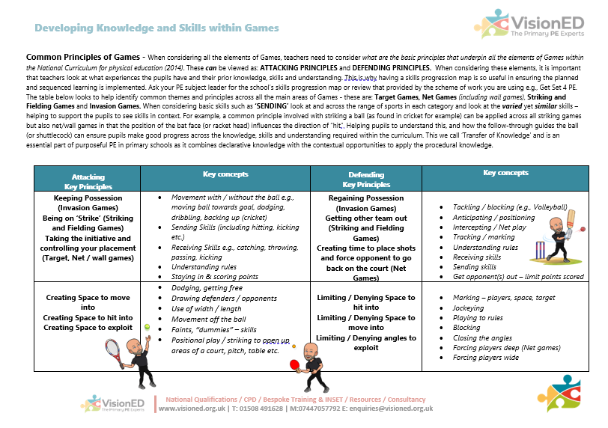

Slide 36
Section 3 Curriculum Content
Your curriculum approach.
So – how is the content of your curriculum chosen? The areas of activity / sports?
Discuss with a colleague(s)
What areas of activity and / or sports have you chosen and why?
Be prepared to explain the inclusion of sports etc. in your long-term plan / curriculum map.

Slide 37
What’s in, what’s not?
Being able to tell the narrative of why your curriculum looks the way it does should rely and be based upon sound educational principles
Reflect the need of pupils / community context
Deliver the aims of the national curriculum
Link and develop pupils K,S,U in a progressive sequence
Block pupils learning to give time, richer understanding
The local football club can only work with us on certain days
We had the opportunity to have 3 weeks of <insert>

Slide 38
I don’t need to include Football in our curriculum - prove me wrong

Slide 39
Sticking with Games
How do sports chosen link and align with each other (e.g. balance of games categories, common principles)
Do you provide sufficient depth and time to develop motor competencies, rules, strategies and tactics across your curriculum?
Do you provide opportunities to revisit, re-encounter, recap learning and the opportunities for subsequent transference of learning (application, selection)

Slide 40
Across the whole school
Athletics Example - Motor Competencies
EYFS
Negotiating space and obstacles safely.
Demonstrating strength, balance and coordination when playing.
Moving energetically (running, jumping, dancing, hopping, skipping and climbing)
End KS 2
Running for speed and for distance
Throw a range of implements for distance
Jump for height and distance and combined with run (hurdles)
Domain specific actions e.g. hurdles, javelin

Slide 41
‘A mile wide and an inch think’ (D. Kirk 2010)
Often citied as a means to encourage young people to find an activity that they enjoy and to foster subsequent lifelong participation, whilst less depth of content knowledge can be attractive to teachers. Greater depth through fewer activities could support young people to develop greater competence and confidence, increasing their subsequent likelihood of participating in physical activity across the life course.
(M. Whitehead, 2010)

Slide 42
Ofsted are at pains to stress that doing fewer activities but learning more and doing more make a real difference
Common phrase is ‘know more and do more’
Time needs to be used strategically to cover the development of competence (confidence) across the three pillars
There needs to be clarity on what it means to get better in PE

Slide 43
A personal plea
We have covered a lot of things today
Please don’t forget to consider the curriculum from the pupils’ perspective
Where is the ‘awe and wonder,’ the ‘Excellence and Enjoyment’

Slide 44
Section 4 Paddle, Snorkel, Dive
When considering the Curriculum this analogy can be quite helpful to reflect upon the outcomes for pupils
It also leads us nicely into thinking about the most challenging questions we can face when asked during a ‘Deep Dive’
Let’s take a look – and a deep breath!

Slide 45
Question 1 Learning Transition
Question 1 - Learning Transition How well does the KS1 curriculum introduce pupils to your subject and build upon learning from EYFS? Consider – what do I know? How do I know it? What evidence do I have? What is the impact?
Do you talk / plan with your EYFS lead?
Is PE taught in EYFS (explain)
What % of pupils achieve a Good Level of Development (GLD) by the end of the Foundation Stage?
How does Physical Development fair in Early Years?
Are any Gaps or issues identified and interventions planned? Screening? Albert Pye and Ravensmere exemplification

Slide 46
Question 2 Content
Why were the units of work on your curriculum map chosen?

Slide 47
Question 3 Sequence
What rationale do you have for the order in which content is taught over time?

Slide 48
Question 4 Links
How are you approaching the teaching of specific subject vocabulary in your subject?

Slide 49
Question 5 Progression
How are you planning for progression in PE?

Slide 50
Learning Objectives
To reflect upon current practice, share ideas and practice, challenge practice
To review your curriculum offer and its alignment with your wider school vision and values, aims and ethos to place PE at the heart.
To consider what it means to ‘Get Better in PE’ in your school
How will ALL pupils be inspired to succeed and excel?
Reflect upon your provision – is it ambitious enough?
How are motor competencies developed along with knowledge of rules, strategies and tactics?
How is confidence and competence developed to ensure the NC aims as well as helping to ensure pupils are informed performers who make healthy participation and active life choices

