Slide 1

Our 5th PE Annual Conference 2023
Exploring the New PE Premium Guidance

Slide 2

Exploring the PE Premium
1.00pm: SGO Updates
1.15pm: Martin Radmore
2.15pm Sharing Best Practices
2.30pm: Break - Tea and Coffee
2.50pm: Workshop Rotation 1
3.20pm: Workshop Rotation 2
3.50pm: Workshop Rotation 3
4.20pm: Closing address
4.30pm: Depart
(Workshops - Inclusive Equality, equal access to sport for boys and girls, Physical Literacy)

Slide 3





School Games Mark 22/23
Ringsfield
Woods Loke Primary
Dell Primary
Kessingland
Somerleyton
Roman Hill
Pakefield
Brampton
Worlingham
Albert Pye
Red Oak
Ashley School
Corton

Slide 4

25 Primary Schools Registered (76%)
Pakefield - RPC
Somerleyton - RPC
St Benet’s - RPC
St Marys - RPC
Albert Pye - RPC
The Limes - RP
Woods Loke – RP
Bramfield – RPC
The Limes – RP
Worlingham – RPC
Westwood - RC
Bramfield - RC
Brampton - RPC
Carlton Colville - RPC
Corton - RPC
Elm Tree - R
Grove - RP
Gunton – RP
Dell – RPC
Phoenix – RPC
Poplars – RP
Saint Felix – RC

Slide 5

Marina Dance Show – Eco Theme

Slide 6


Free Resources

Slide 7


Slide 8
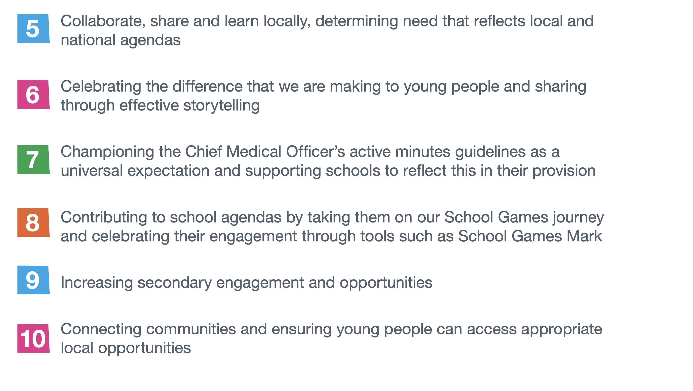

Slide 9
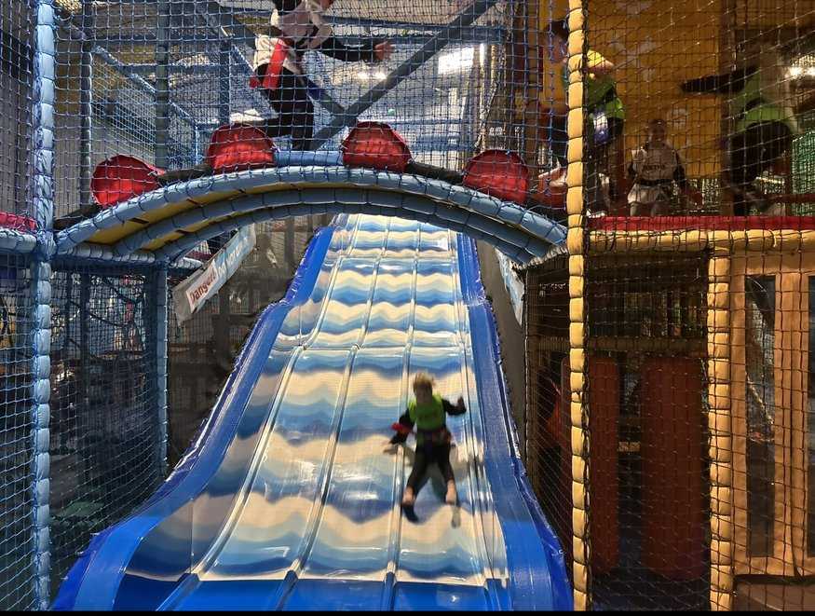
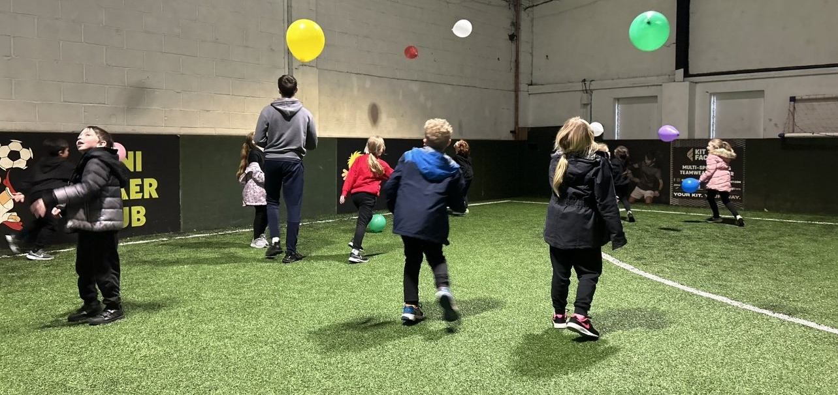
New Approaches for 2023/24
Connecting with Community Venues
Y6/7 Events
First event 4th October – Inclusion Festival

Slide 10


Staff Training
Gymnastics on 29 Sept -1.00-4.00pm – At Whitehouse PC School in Ipswich
New to Leading PE – 10th October – Virtual – 3.45PM-5pm
1 place per all schools outside Ipswich area – if they want to book 2 places there will be a £50 charge - if schools cancel less than 72 hrs before the event they will be invoiced
YST – Physical Literacy Course – 24th November
LTA – Tennis Course – 7th February

Slide 11

Active Primary School of the Year

Slide 12

Contact Linda Dorset
Linda.Dorset@activesuffolk.org
07407829415
Suffolk Daily Mile Champion

Slide 13



The Primary PE and Sport Premium
Thinking Strategically,
Acting for ALL pupils,
Now & into the future

Slide 14
Confidence & Competence
The inter-play and synergy of these two words for us in PE
Confidence can be key to helping pupils develop Competence
Competence can be key to unlocking and developing Confidence
Many pupils lack Confidence – how does our programme help this?
Many pupils lack Competence – how do we develop this?
Every pupil is different
Just think about each word as we chat about our PESSPA offers today

Slide 15
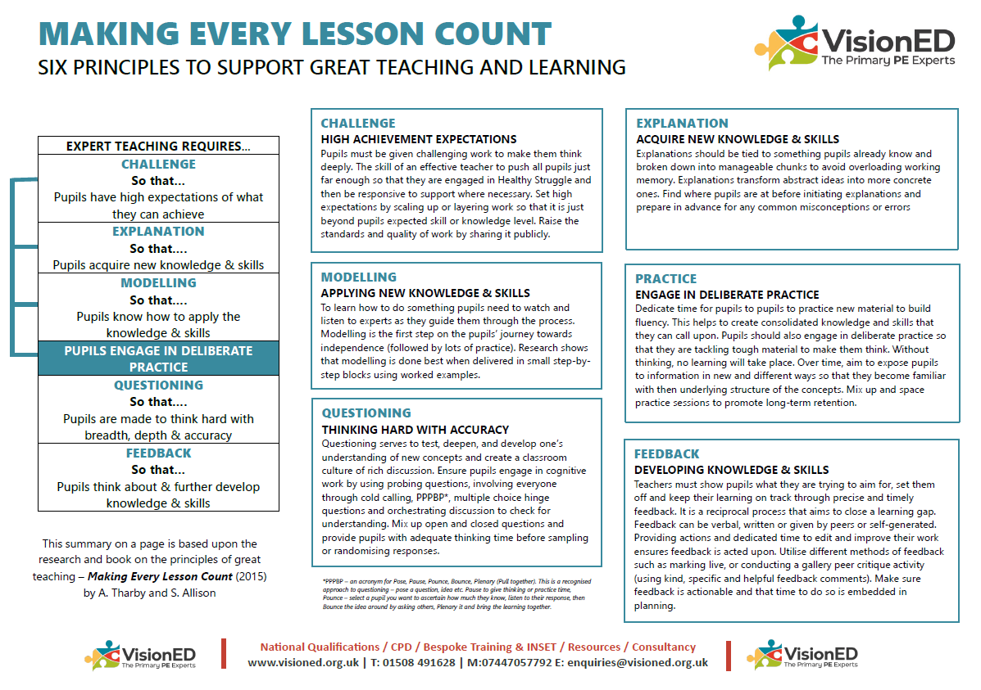
Making Every Lesson Count
If you haven’t seen it already, take a look at the work of Andy Tharby and Shaun Allison – Six Principles to support Great Teaching and Learning
Challenge
Explanation
Modelling
Practice
Questioning
Feedback
Awareness offers the potential to support developing pupils confidence and competence to allow greater progression

Slide 16
PE&SP - Purpose & Rationale
Schools must use the PE and sport premium to:
build capacity and capability in the school and make sure that improvements made to the quality of PE, sport and physical activity provision now are sustainable and will benefit pupils joining the school in future
develop or add to the PE, sport and physical activity that the school provides

Slide 17

CPD for staff
‘Schools should see the continued professional development (CPD) of teachers as a key priority to make sure that the future quality of the teaching of PE, sport and physical activity is sustainable. This includes providing staff with:
professional development
mentoring
appropriate training
access to external resources’

Slide 18
New emphasis
Schools should use it to make additional and sustainable improvements to the PE, sport and physical activity they provide, such as:
funding high-quality PE and sport for at least 2 hours a week, complemented by a wide range of extracurricular sport and competitive opportunities
providing or improving equal access to sport for boys and girls

Slide 19
5 Key Indicators
Schools should prioritise PE and sport premium spending to improve in the following 5 key areas:
increasing all staff’s confidence, knowledge and skills in teaching PE and sport
increasing engagement of all pupils in regular physical activity and sport
raising the profile of PE and sport across the school, to support whole school improvement – Do you use OAA?
offer a broader and more equal experience of a range of sports and physical activities to all pupils
increase participation in competitive sport

Slide 20
New Reporting Template
New format – plus electronic portal soon
Swimming – asks two new questions:
If your schools swimming data is below national expectation, you can choose to use the Primary PE and sport premium to provide additional top-up sessions for those pupils that did not meet National Curriculum requirements after the completion of core lessons. Have you done this?
Have you provided CPD to improve the knowledge and confidence of staff to be able to teach swimming and water safety?

Slide 21
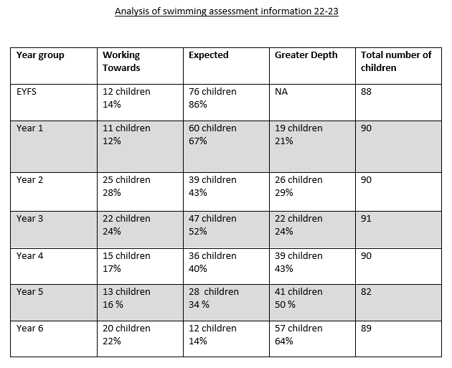
Understanding WHO these pupils are can be key to making real impact
Data over time will help you see the progress of individuals
How will you use such data to make the impact

Slide 22

Consider
Look at your swimming data
How can you improve it across the three key strands?
Who takes the pupils swimming?
How involved are they?
Can they ‘Support the pupils’ learning poolside’?
Swim England – school swimming and water safety charter school costs just £36 inc. VAT and provides incredibly useful resources

Slide 23
So ultimately it is about building capacity and capability to sustain high-quality PE / PESSPA(H)
Equal access – to sports but please consider the curriculum
Mini-cohorts (SEND, EAL, LAC, Boys/Girls, Service children etc)
Have you looked at it? What did you find?
Have you asked the pupils – perception could be different as pupils might perceive that certain activities are skewed towards a particular group. [Pupil voice / School Sports Council / Council]

Slide 24
Where are you now?
How has the £100K+ ring-fenced investment been utilised so far in your school?
What would you say is the biggest impact it has made?
How evident is the spend?
Do parents even know about what you receive?
Is it ‘Sports Premium’ or PE and sports premium on your website?
Is there a link governor?
How are decisions made about spend – strategy, reaction?

Slide 25
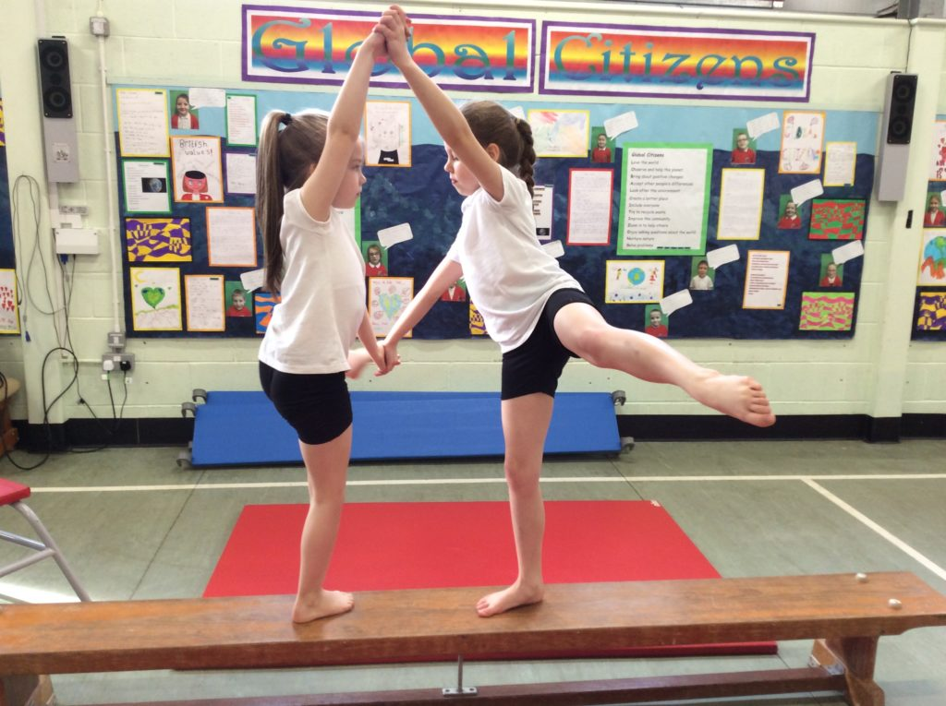
RAG Review – HQ PE
Quick task
How has it improved outcomes for groups – talk to your neighbour

Slide 26
RAG Review – Physical Literacy
Do your pupils have:
The motivation, confidence, physical competence, knowledge and understanding to value and take responsibility for engagement in physical activities for life
Physical – the skills and fitness a person acquires and applies through movement
Affective – the attitudes and emotions a person has towards movement and the impact these have on their confidence and motivation to move including a Social – a person’s interaction with others and the environment in relation to movement
Cognitive – a person’s understanding of how, why, and when they move, their knowledge and understanding

Slide 27
RAG Review – Physical Literacy
Do your pupils have:
The motivation, confidence, physical competence, knowledge and understanding to value and take responsibility for engagement in physical activities for life
Physical – the skills and fitness a person acquires and applies through movement
Affective – the attitudes and emotions a person has towards movement and the impact these have on their confidence and motivation to move including a Social – a person’s interaction with others and the environment in relation to movement
Cognitive – a person’s understanding of how, why, and when they move, their knowledge and understanding

Slide 28
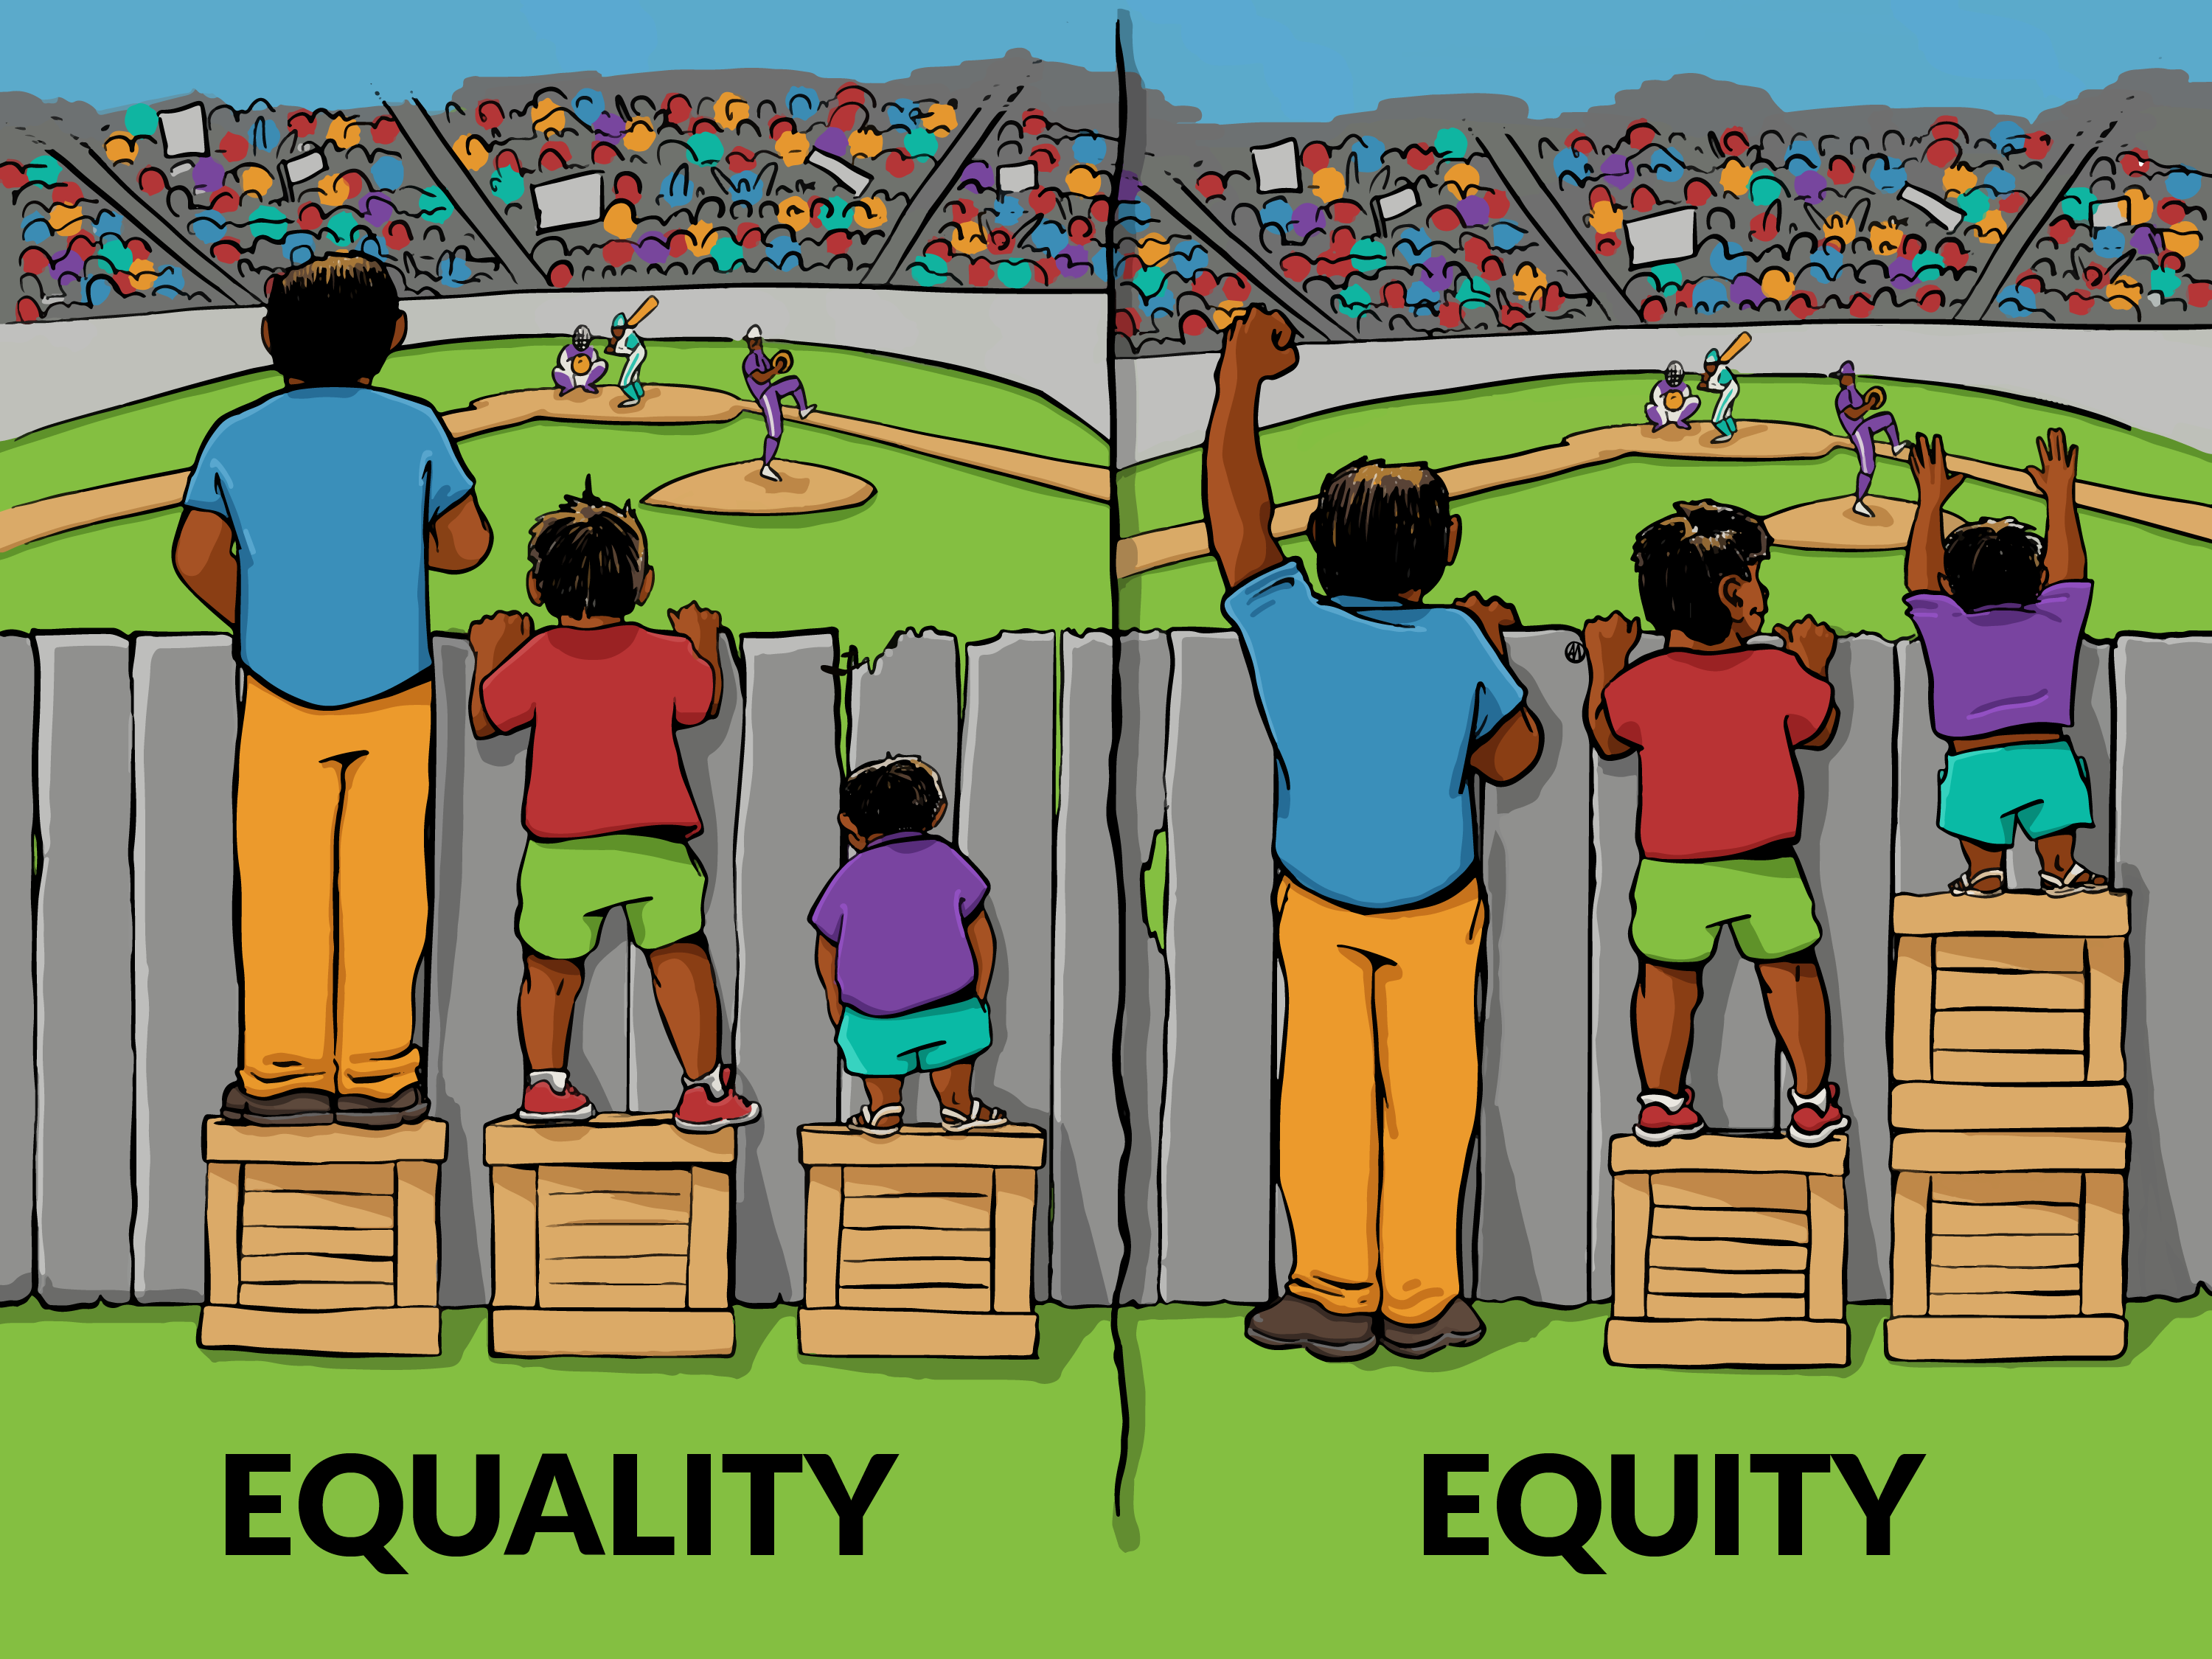
PE at your School
For me curriculum is key – 100% of pupils
Developing Physical, Affective (including Social, Cognitive Domains
  -planned, sequenced, progressive
Now 2 hour time target again
ALL pupils – how do you meet needs Equality & Equity
  Practical: Do you have the equipment to support equity? Now and into future - stock
  Size, colour, texture, composition, adapted variants

Slide 29
PESSPA at your school
Who teaches Physical Education (PE)?
How are they supported? SoW, CPD, Assessment, Monitoring & Eval.
Staff PE Skills Audit document can be very helpful
Who supports play, physical development/activity?
How are they supported? Resources, CPD, strategic use.
Who provides & supports sport, competition, OSHL/extra-curricular?
How are they supported? Funded? Monitored/evaluated?

Slide 30
Strategic Planning
2 full years funding guaranteed 2023/24 & 2024/25
What are your strategic plans for PE?
Key language:
Additional
Sustainable, Capacity, Capability
Improved, High-quality
Continued Professional Development (CPD) [confidence, competence, understanding
Inclusive, Equitable
Wide range of extra-curricular sport & competitive opportunities

Slide 31
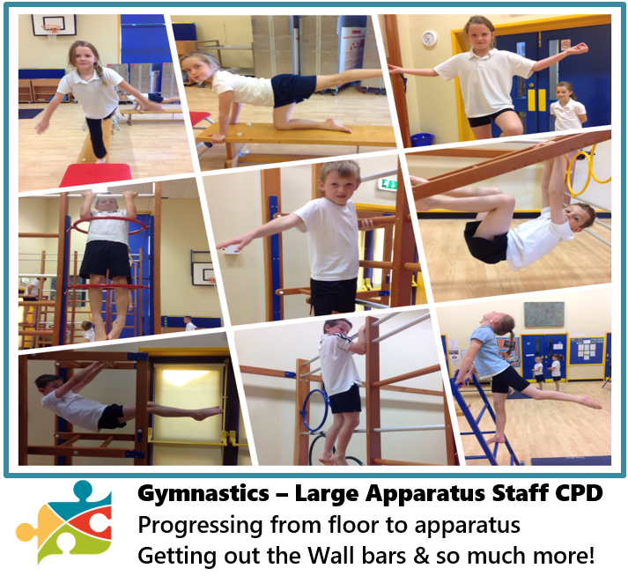


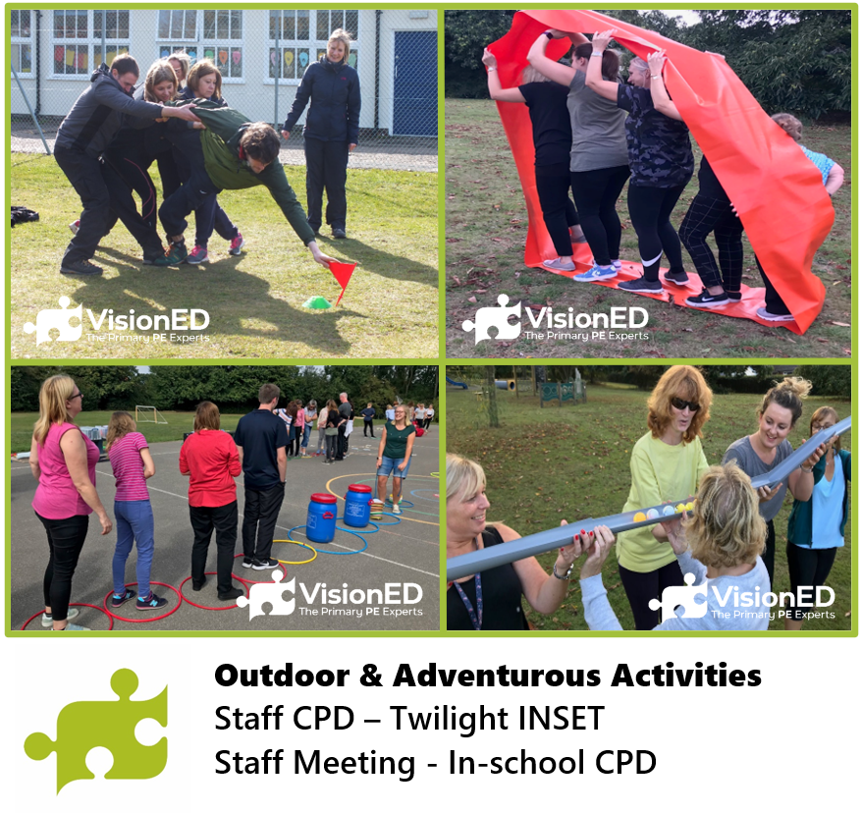
VisionED
We are here to help and can offer courses, bespoke CPD and national qualifications
Twilights, half-days, full days

Slide 32

CPD Survey
Participants can join at slido.com with #1792 606

Slide 33
Workshop 1&2 Questions
Inclusive Equality and equal access to sport for boys and girls
What do you do in your curriculum to support these leaners?
What do you do out of school hours to support these leaners?
What could you implement in your school to improve their school experience?
Do you use Student Voice to guide the provision these leaners receive?

